Slide 1
Kanban & General considerations
3AGIL - Day 3

Slide 2
Course Summary
Kanban (30’)
Trello (2h)
General considerations (4h)
  Lean
  Scaling Scrum
  XP
  Test-driven development
  CI/CD
DevOps (30’)

Slide 3
Kanban

Slide 4
Definition
Kanban is a method for managing and improving workflows that was developed by Toyota in the 1950s.
It is based on the principles of just-in-time (JIT) production
Aims to increase efficiency and reduce waste by :
visualizing work
limiting work-in-progress
continuously improving processes.

Slide 5
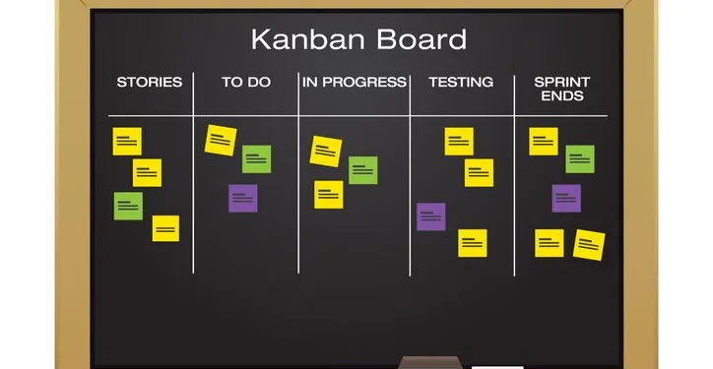
Visualizing work
Kanban board: A visual representation of the work process, showing the status of each task or item as it moves through the workflow.

Slide 6
Kanban Best Practices
Work-in-progress (WIP) limits: Maximum number of tasks that can be in progress at each stage of the workflow, to prevent overloading and bottlenecking.
Pull system: A system in which work is only started when there is capacity to complete it, rather than pushing work through the process regardless of capacity.
Continuous improvement: Regular review and optimization of the workflow to identify and address bottlenecks, improve efficiency, and reduce waste.
All in all : Agile best practices

Slide 7
Pop-quizz ! (10’)
Alone or in pairs, try and link Kanban best practices to SCRUM’s ceremonies, roles and artifacts. Everything isn’t supposed to fit, but there are obvious overlaps !
Take the time to share your results and explain why you linked them.
Notes:
Both SCRUM and kanban emphasize the importance of visualizing work and tracking progress through the use of a board or other visual tool.
Both SCRUM and kanban use iterative and incremental development, with a focus on delivering small increments of work frequently.
Both SCRUM and kanban involve regular review and optimization of the process to identify and address bottlenecks and improve efficiency.
Both SCRUM and kanban place a strong emphasis on teamwork and collaboration, and involve regular meetings and communication among team members.
WIP Limitation -> Planning poker, complexity evaluation & Sprint Backlog
Pull System : Product & Sprint backlog, Sprint Planning
Continuous improvement : Sprint retrospective

Slide 8
Trello

Slide 9
Introduction
Trello is a project management tool that helps teams organize and prioritize their work by using a visual, flexible system of boards, lists, and cards.
Basically : a Kanban board

Slide 10
Key components
Boards: A board is a visual representation of a project or workflow, and can contain lists and cards.
Lists: A list is a column on a board that contains cards, which represent tasks or items.
Cards: A card is a representation of a task or item, and can contain details, attachments, and comments.
Labels: Labels are tags that can be used to categorize and prioritize cards.
Checklists: Checklists are lists of tasks or items within a card that can be checked off as they are completed.

Slide 11
Exercise (1h30+) - Same Groups as yesterday
Go to Trello.com, create an account.
Create a board, have your group connect to the same board
Create and organise the board to manage your work :
  Use your product/sprint backlog
  Use your definition of done
  Create as many lists as you feel should be needed
  Inspire yourself from Kanban AND Scrum
  Create template for your cards
  Automate your cards
  Use Checklists to track work
  Fill your board with your Product/Sprint backlog content
Take the time to present and review your board with other groups : inspire yourself from others
Notes:
Here, it’s critical to ensure that each group is invested in creating a solid board. You can take some time at the beginning of the exercise to present some key fuctionalities. They aime here is to have them try to optimise / automate / simplify their project management as much as possible, as tool they can use both in there personal/student and professional lives.

Slide 12
What else is Agile ?

Slide 13
Lean
Lean is a business philosophy that focuses on maximizing customer value while minimizing waste. It is based on the principles of continuous improvement, respect for people, and a focus on delivering value to the customer.

Slide 14
Key Component of Lean
Value stream mapping: Identifying and analyzing the flow of value from the customer's perspective, in order to identify and eliminate waste.
Continuous improvement: Regularly identifying and addressing opportunities for improvement in order to increase efficiency and reduce waste.
Respect for people: Recognizing the value and potential of all team members and creating an environment that empowers and enables them to contribute.
Customer focus: Focusing on delivering value to the customer, and using customer feedback to guide decision-making and improvement efforts.

Slide 15
Lean Principles
Define value from the customer's perspective
Identify and eliminate waste
Create flow in the value stream
Use pull systems to trigger production
Strive for perfection
Notes:
Define value from the customer's perspective: In lean, value is defined as anything that the customer is willing to pay for. It is important to identify and understand the customer's needs and preferences in order to deliver value effectively.
Identify and eliminate waste: Lean is based on the idea of continuous improvement and the elimination of waste. Waste can take many forms, including overproduction, waiting, defects, excess inventory, excess motion, unnecessary processing, and unused talent. Lean principles aim to identify and eliminate these types of waste in order to increase efficiency and reduce costs.
Create flow in the value stream: Flow refers to the smooth and efficient flow of value through the production process. Lean principles aim to create flow by identifying and eliminating bottlenecks and other disruptions in the process.
Use pull systems to trigger production: In a pull system, production is triggered by demand from the customer, rather than being pushed through the process based on a predetermined schedule. This allows the organization to be more responsive to changing customer needs and reduce excess inventory.
Strive for perfection: Lean principles encourage organizations to continuously improve and strive for perfection by identifying and addressing problems and defects as they arise, and by regularly reviewing and optimizing processes.

Slide 16
Lean Tools and Techniques
Value stream mapping
Six Sigma
Kanban
5S
Standardized work
Visual management
Root cause analysis
Kaizen events
Notes:
Value stream mapping: Value stream mapping is a visual representation of the flow of value from the customer's perspective, including all the activities and steps involved in producing and delivering a product or service. It is used to identify and eliminate waste in the process.
Six Sigma: Six Sigma is a methodology for improving processes by identifying and eliminating defects and variability. It uses statistical analysis and data-driven problem-solving to identify root causes and implement solutions.
Kanban: Kanban is a method for managing and improving workflows that was developed by Toyota in the 1950s. It is based on the principles of just-in-time (JIT) production and aims to increase efficiency and reduce waste by visualizing work, limiting work-in-progress, and continuously improving processes.
5S: 5S is a methodology for organizing and maintaining a clean, efficient, and safe work environment. It involves sorting, straightening, shining, standardizing, and sustaining (the "5S's") in order to create a visual and orderly workplace.
Standardized work: Standardized work is a systematic approach to documenting and improving work processes. It involves identifying and documenting the most efficient and effective way to perform a task, and then using this standard as a basis for continuous improvement.
Visual management: Visual management is a lean technique that uses visual aids, such as charts, graphs, and other visual displays, to communicate information and improve communication and collaboration within an organization.
Root cause analysis: Root cause analysis is a problem-solving method that aims to identify the underlying causes of problems or defects, rather than just treating the symptoms. It is used to prevent problems from recurring by addressing the root causes of issues.
Kaizen events: Kaizen events, also known as "rapid improvement events," are focused improvement activities that involve a cross-functional team working intensively to identify and address problems or opportunities for improvement over a short period of time.

Slide 17
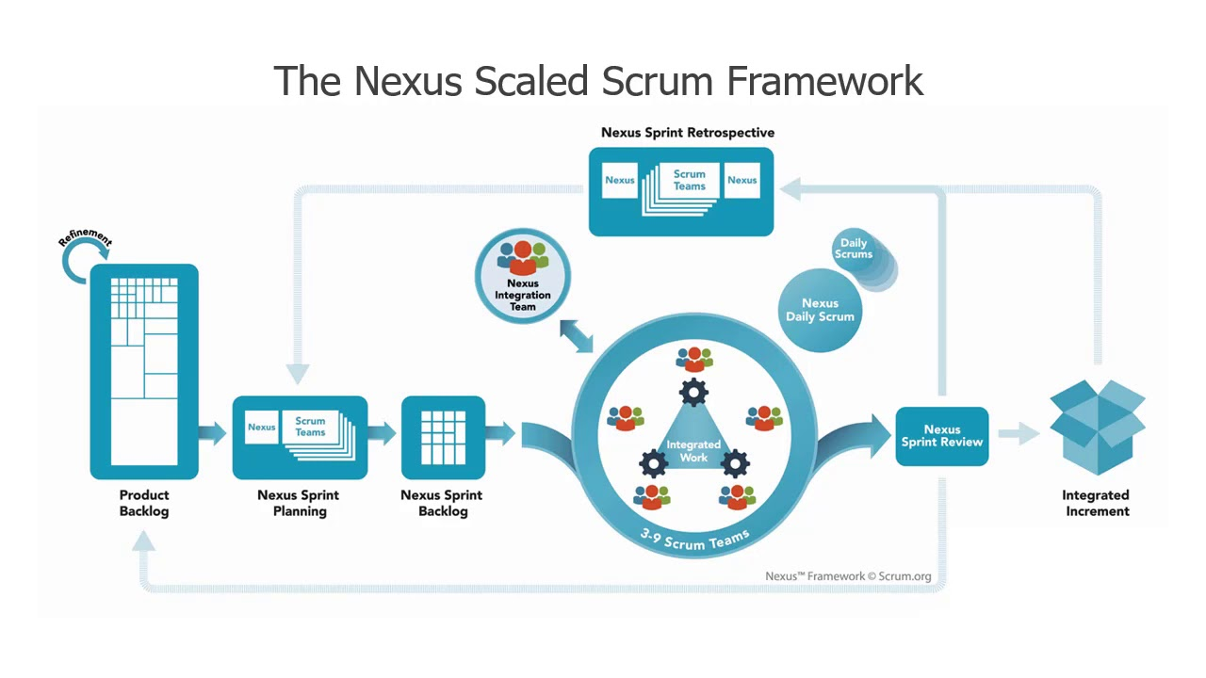
Scaling Scrum
Scaling SCRUM is the process of adapting the SCRUM framework to meet the needs of large, complex projects or organizations.

Slide 18
How is SCRUM generally scaled ?
Multiple SCRUM teams: Using multiple SCRUM teams to work on different parts of a large project or product.
SCRUM of SCRUMs: Using a SCRUM-like process to coordinate and align the work of multiple SCRUM teams.
Product owners and product backlogs: Using a dedicated product owner and product backlog to represent the needs and priorities of the organization as a whole.
Release and sprint planning: Planning releases and sprints at the organizational level, rather than at the team level.

Slide 19
Several Scaling SCRUM Frameworks
Large-Scale Scrum (LeSS)
Scaled Agile Framework (SAFe)
Nexus
Scrum@Scale

Slide 20
Exercise (1h30’+) - Groups of 3-5
Write a 5-6 slide presentation about one of the Scaling Scrum Framework.
Present it to the class.
Your goal is to make sure they have an understanding of how the framework works.
If needed, use a whiteboard to outline the workflow.
Take some time to research, understand, illustrate, and outline similarities with information you already have.

Slide 21
eXtrem Programming
Key component :
Pair Programming
Test-driven development (TDD)
Continuous integration
Continuous delivery
Collective ownership
Customer collaboration
Notes:
Pair programming: Pair programming is a software development technique in which two programmers work together at a single workstation, with one person writing code and the other reviewing and providing feedback in real-time.
Test-driven development (TDD): In TDD, developers write automated tests for new code before writing the code itself, in order to ensure that the code is testable and meets the desired requirements.
Continuous integration: Continuous integration is the practice of integrating code changes into a shared repository frequently, in order to detect and resolve conflicts early.
Continuous delivery: Continuous delivery is the practice of automating the build, test, and deployment process in order to deliver new features to users as quickly and safely as possible.
Collective ownership: Collective ownership is the practice of encouraging all team members to contribute to and take responsibility for the codebase.
Customer collaboration: XP emphasizes the importance of frequent and open communication with the customer in order to ensure that the product meets their needs and expectations.

Slide 22
Test-driven development
TDD is a software development methodology in which developers write automated tests for new code before writing the code itself.
The tests are used to define the desired behavior and requirements for the code, and are run after the code is written to ensure that it is working as expected.
To practice TDD, developers follow a specific process called the "test-driven development cycle," which consists of writing a test, running the test and confirming that it fails, writing the code to make the test pass, running the test again to ensure that it passes with the new code, and refactoring the code as needed.

Slide 23
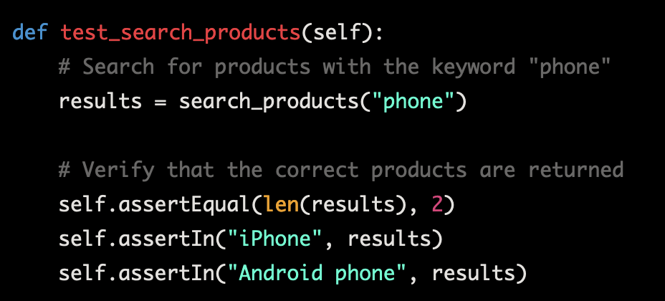
TDD : Example
Let's say we are developing a new feature for a website that allows users to search for products. The feature should search for products based on keywords and return a list of matching products.
Step 1: Write a test that defines the desired behavior or functionality of the code.
Notes:
def test_search_products(self):
# Search for products with the keyword "phone"
results = search_products("phone")
# Verify that the correct products are returned
self.assertEqual(len(results), 2)
self.assertIn("iPhone", results)
self.assertIn("Android phone", results)

Slide 24
TDD : Example (2)
Step 2: Run the test and confirm that it fails, since the code has not yet been written.
Since we have not yet written the code for the search_products function, running the test at this point should result in an error.

Slide 25
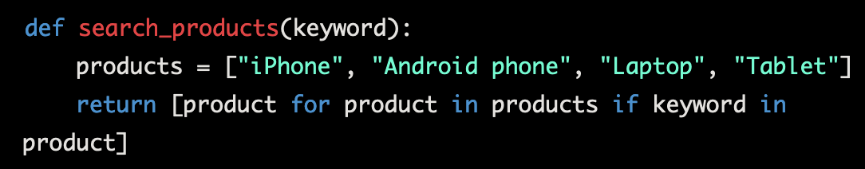
TDD : Example (3)
Step 3: Write the minimum amount of code necessary to make the test pass.
To make the test pass, we need to write the search_products function. The function should search for products with the given keyword and return a list of matching products. The code might look something like this:
Notes:
def search_products(keyword):
products = ["iPhone", "Android phone", "Laptop", "Tablet"]
return [product for product in products if keyword in product]

Slide 26
TDD : Example (4)
Step 4: Run the test again to ensure that it passes with the new code.
Now that we have written the search_products function, running the test again should result in the test passing.
Step 5: Refactor the code as needed to improve its design or performance, while ensuring that the test continues to pass.
If we want to further improve the search_products function, we might refactor the code to optimize the search algorithm or add additional functionality. We should ensure that the test continues to pass after any refactoring to ensure that the desired behavior and requirements are still being met.

Slide 27
TDD Exercise (30’+)
Take 1 to 3 user stories in your product backlog, and write the algorithmic version of the test for it (depending on complexity)
Then write the code to answer the test.
If needed, break down the US in smaller chunks of code.

Slide 28
Continuous Integration (CI)
software development practice in which developers integrate code changes into a shared repository frequently, typically several times a day
detect and resolve conflicts early
ensure that the codebase is always in a stable and deployable state

Slide 29
Benefit of CI
Improved quality and reliability of software: By integrating code changes frequently, developers can catch and fix defects early on, which can help to reduce the number of bugs in the codebase and improve the overall quality of the software.
Faster delivery of new features: By integrating code changes frequently, developers can deploy new features more quickly, which can help to increase the speed at which new functionality is delivered to users.
Increased collaboration and communication within the team: Continuous integration encourages developers to work closely together and communicate regularly, which can help to improve collaboration and coordination within the team.
Greater visibility of progress: By integrating code changes frequently, developers can track progress more accurately and identify any issues or blockers that may be affecting the project.

Slide 30
CI Tooling
Jenkins: Open-source automation server for building, deploying, and automating projects.
Travis CI: Cloud-based CI platform for testing and deploying software projects.
CircleCI: Cloud-based CI platform for building, testing, and deploying software.
GitLab CI: Built-in CI/CD platform for GitLab, a web-based Git repository manager.
Monitors the code repository for changes, automatically runs series of tests and checks when code is committed.
If the tests and checks pass, the code is integrated into the repository. If any issues, alert the team on what needs to be fixed.

Slide 31
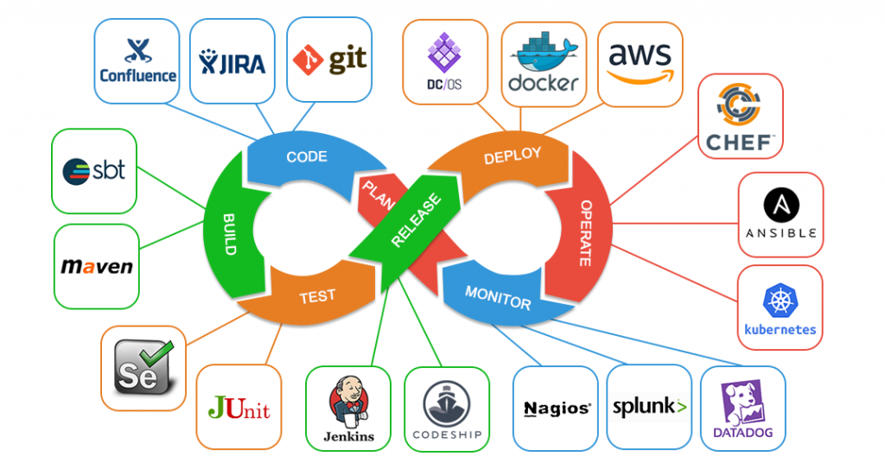
Continuous Delivery (CD)
software development practice in which the build, test, and deployment process is automated, allowing developers to deliver new features to users as quickly and safely as possible.

Slide 32
Time to market
Time to market is an important consideration for businesses, as it can impact their ability to compete and capture market share.
Shorter time to market can be an advantage, as it allows businesses to respond more quickly to market demand and customer needs.
There are a number of factors that can impact time to market, including the complexity of the product or service, the efficiency of the development process, and the availability of resources.

Slide 33
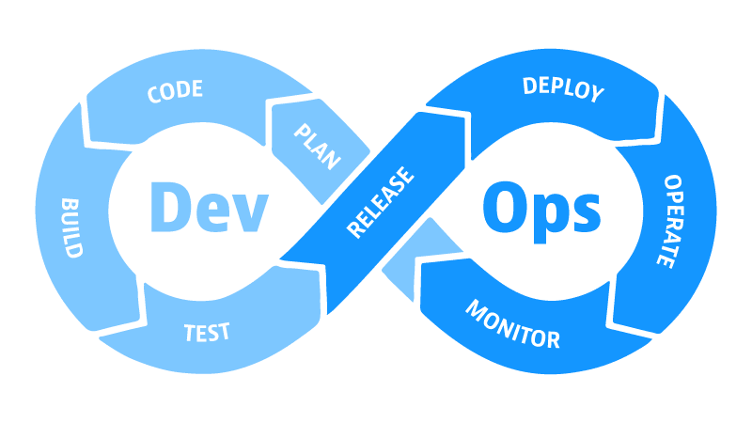
DevOps
Set of practices and principles that aim to improve collaboration and communication between development and operations teams, and to accelerate the delivery of software and services.

Slide 34
DevOps component
Continuous integration and continuous delivery (CI/CD): Automating the build, test, and deployment process to enable frequent and reliable releases of software and services.
Infrastructure as code: Using code and automation to manage and configure infrastructure, rather than manual processes.
Monitoring and observability: Using tools and techniques to monitor the performance and behavior of systems in real-time, and to quickly identify and resolve issues.
Collaboration and communication: Encouraging collaboration and communication between development and operations teams, and promoting a culture of shared responsibility for the success of the product or service.

Slide 35
Benefits of DevOps
Improved software quality and reliability
Faster delivery of new features and updates
Increased efficiency and productivity
Greater agility and flexibility
Enhanced collaboration and communication within the team

Slide 36
Challenges of Devops
Requires a significant cultural shift for some organizations
May require a high level of discipline and commitment from team members
Can be difficult to implement in a large or complex organization

Slide 37
Knowledge Check (10’)

